Slide 1
Evaluating expressions with and without changing the subject
Expressions and formulae

Slide 2
How our teaching resources are designed for the classroom

Slide 3
I can evaluate an expression where the subject has been changed and where it has not.

Slide 4


The subject of an equation/a formula is a variable that is expressed in terms of other variables. It should have an exponent of 1 and a coefficient of 1.
For example, a is the subject of this formula
but, a² is not the subject of this formula

Slide 5

Evaluating expressions with and without changing the subject.
Rearranging in order to solve
Evaluating without changing the subject

Slide 6
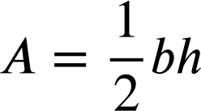
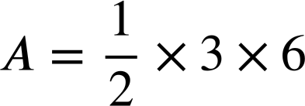
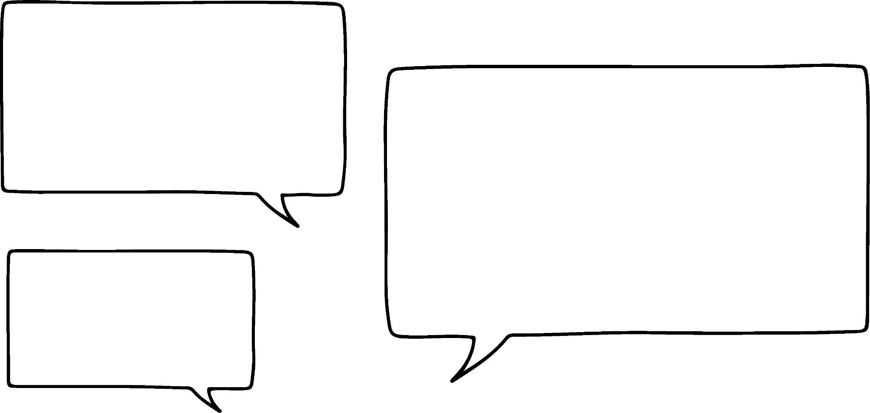
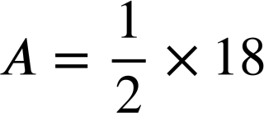
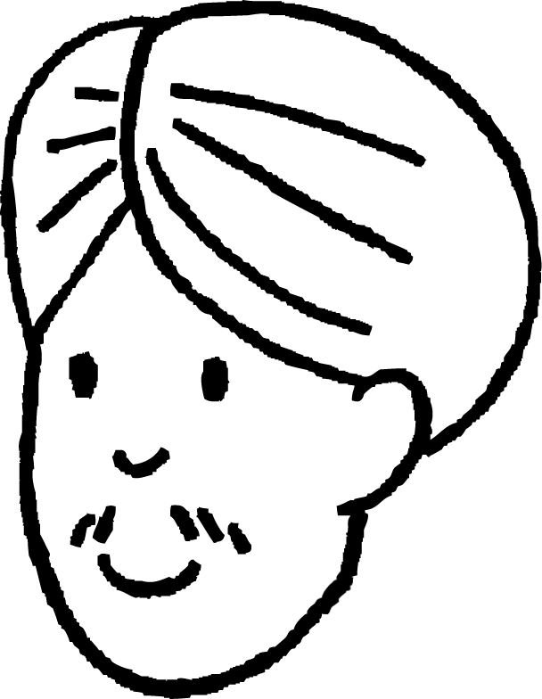
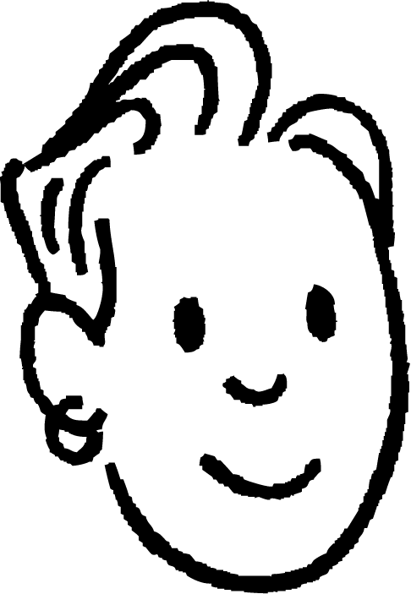
Rearranging in order to solve
Andeep and Sam are studying geometry.
6 cm
We can use this formula to work out the area.
3 cm
The area is 9 cm²

Slide 7
Rearranging in order to solve
Working backwards is where pupils frequently make mistakes with formula.
The area is 30 cm², the height is 6 cm. Find the base.
6 cm
A = 30 cm²
b
I think we start with 30 ÷ 6 which is 5
Yes. Then it’s something to do with ‘halving’ so I think the base is 2.5 cm
Do you agree with Andeep and Sam?

Slide 8
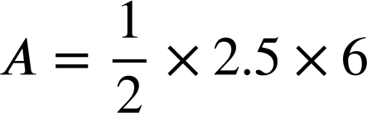
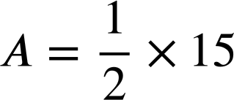
Rearranging in order to solve
6 cm
A = 30 cm²
= 7.5 cm²
b
Yes. Then it’s something to do with ‘halving’ so I think the base is 2.5 cm
I’ll test our answer.
2.5 cannot be right!

Slide 9
Rearranging in order to solve
The reason the area was easy to find in the first problem we saw was because area was the subject of the formula.
6 cm
3 cm
If the unknown we are trying to work out is the subject of the formulae we can work more efficiently.

Slide 10
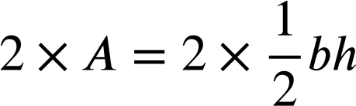

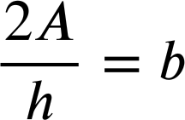
Rearranging in order to solve
Making b the subject of the formula can make Andeep and Sam’s problem more straightforward.

Slide 11
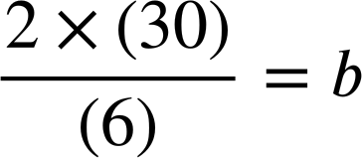
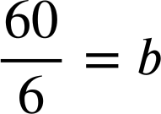
Rearranging in order to solve
The area is 30 cm², the height is 6 cm. Find the base.
6 cm
We can use this arrangement of the formula to work out the base.
A = 30 cm²
b
The base is 10 cm
That was much easier after rearranging the formula!

Slide 12
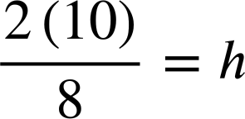
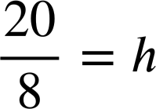
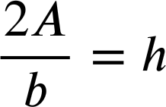
Rearranging in order to solve
The area is 10 cm², the base is 8 cm. Find the height.
Rearrange the formula to make h the subject, then evaluate to find the height.
h
A = 10 cm²
8 cm
h = 2.5 cm

Slide 13
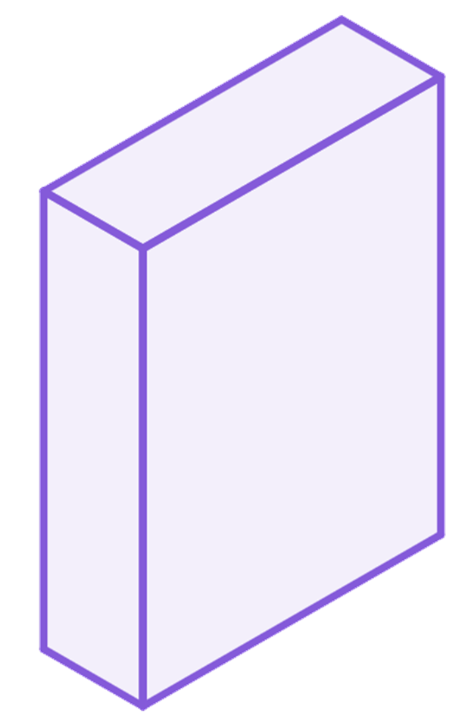
Rearranging in order to solve
1) The formula for volume of a cuboid can be written as V = lwh
Rearrange the formula to make w the subject. Then evaluate to find the width of a cuboid with length 1.6 cm, height 2.25 cm, and volume 1.44 cm³
h
You may use a calculator to do the substitution.
l
w

Slide 14
Rearranging in order to solve
2) The formula for the area of a circle is A = πr²
Rearrange the formula to make r the subject. Then evaluate to find the radius of a circle with area 80 cm²
Give your answer to 2 d.p.
r
You may use a calculator to do the substitution.

Slide 15
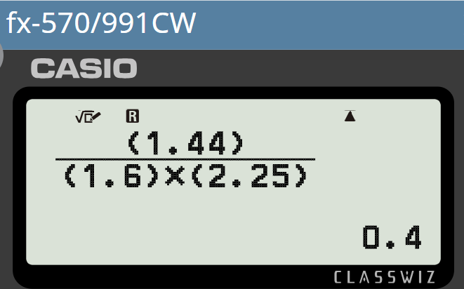
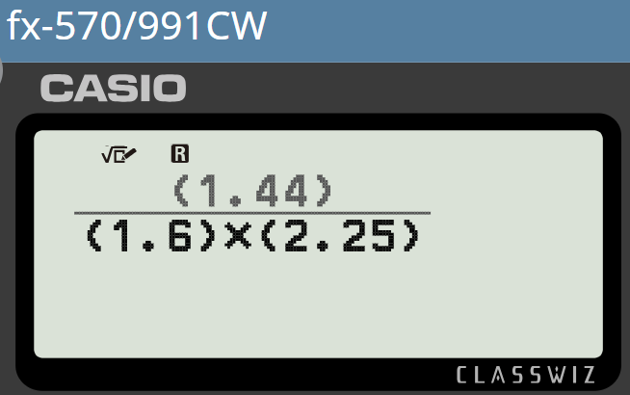
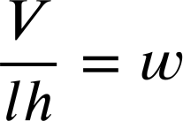
Rearranging in order to solve
1) The formula for volume of a cuboid can be written as V = lwh
Rearrange the formula to make w the subject. Then evaluate to find the width of a cuboid with length 1.6 cm, height 2.25 cm, and volume 1.44 cm³
h
V = lwh
l
w
w = 0.4 cm

Slide 16
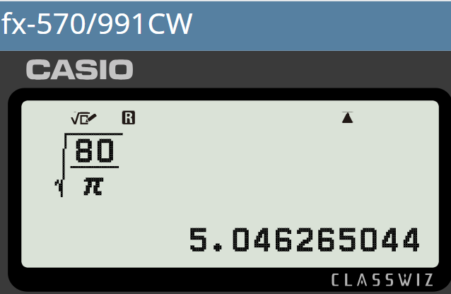
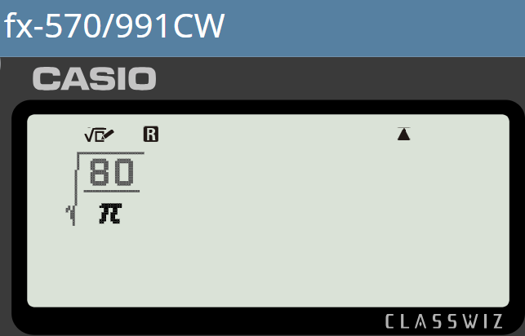
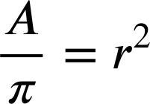
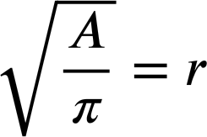
Rearranging in order to solve
2) The formula for the area of a circle is A = πr²
Rearrange the formula to make r the subject. Then evaluate to find the radius of a circle with area 80 cm²
r
A = πr²
r = 5.05 cm (to 2 d.p.)

Slide 17
Evaluating expressions with and without changing the subject.
Rearranging in order to solve
Evaluating without changing the subject

Slide 18
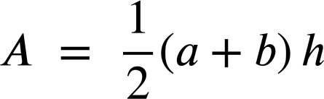
Evaluating without changing the subject
Andeep and Sam are now studying trapeziums.
The area of a trapezium is 70 cm², the lower base length is 9 cm and the upper base length is 5 cm
b
h
Calculate the height.
a
We can rearrange this formula for area to make h the subject.

Slide 19
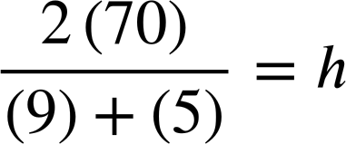

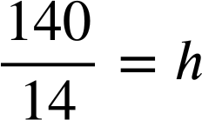
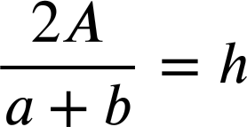
Evaluating without changing the subject
The area of a trapezium is 70 cm², the lower base length is 9 cm and the upper base length is 5 cm
b
Calculate the height.
h
a
I’m not sure that method was any more efficient on this problem!
h = 10 cm

Slide 20
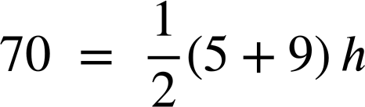
Evaluating without changing the subject
The area of a trapezium is 70 cm², the lower base length is 9 cm and the upper base length is 5 cm
b
Calculate the height.
h
Well done Sam! Your method was much more efficient this time!
a
70 = 7h
We could evaluate without first rearranging.
h = 10 cm
We can evaluate without changing the subject and on occasions this may be more efficient.

Slide 21
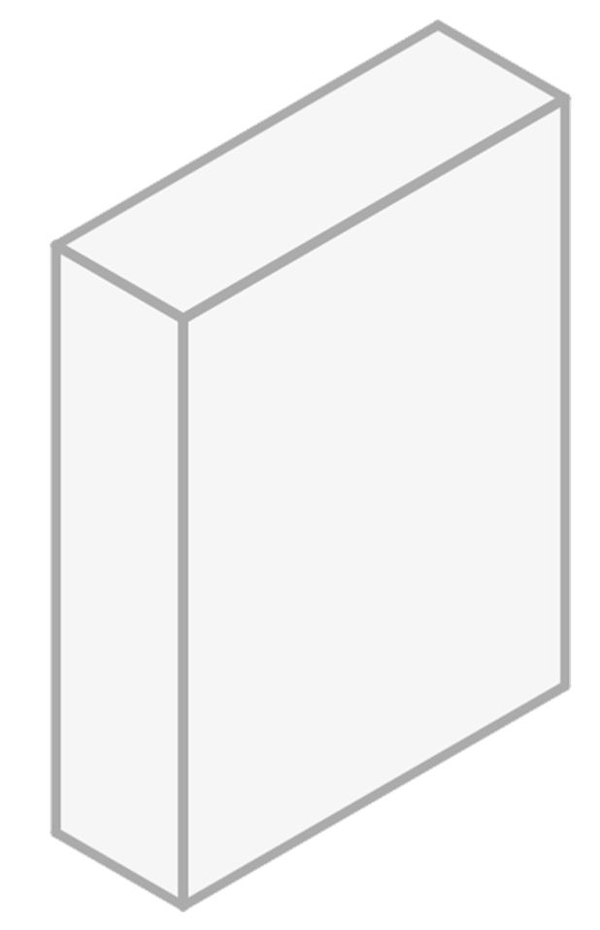
Rearranging in order to solve
A cuboid has width 4.5 cm, height 20 cm, and volume 630 cm³
Substitute into the formula V = lwh and evaluate without rearranging to find the length (l).
h
V = lwh
630 = l × 4.5 × 20
l
630 = 90l
w
l = 7 cm
This method was very efficient.

Slide 22
Evaluating without changing the subject
1) Missing dimensions in a trapezium.
a) A trapezium has area 95 cm², a lower base length of 23 cm and an upper base length of 15 cm
b
h
Substitute without rearranging to find the height (h).
a
b) A trapezium has area 88 cm², a lower base length of 14 cm and a height of 8 cm
Substitute without rearranging to find the upper base (b).
c) Which was the harder problem, (a) or (b)? Write a sentence explaining why and suggest an alternative method for solving.

Slide 23

Evaluating without changing the subject
2) A right triangle has hypotenuse 13 cm, and one shorter length of 12 cm
c
a) Substitute and evaluate without rearranging to find the remaining shorter length.
a
b
b) Rearrange to make a the subject, then substitute to find the remaining shorter length.
c) Compare the approaches in parts a) and b)

Slide 24
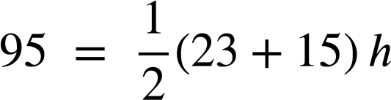
Evaluating without changing the subject
1) Missing dimensions in a trapezium.
b
a) A trapezium has area 95 cm², a lower base length of 23 cm and an upper base length of 15 cm
h
Substitute without rearranging to find the height (h).
a
95 = 19h
h = 5 cm

Slide 25
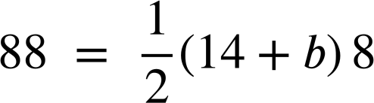
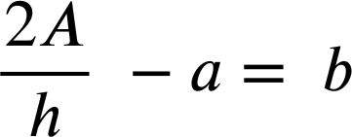

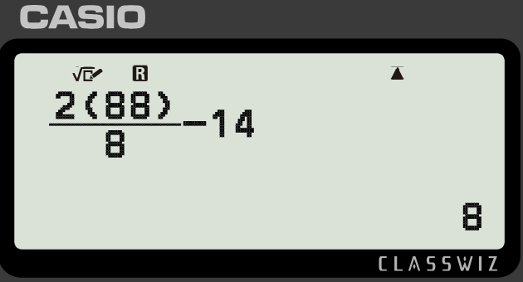
Evaluating without changing the subject
1) Missing dimensions in a trapezium.
b
b) A trapezium has area 88 cm², a lower base length of 14 cm and a height of 8 cm
h
Substitute without rearranging to find the upper base (b).
a
c) Part (b) was the harder problem. It had more steps and involved more skills, therefore more opportunities to make an error.
An alternative method would be to rearrange the formula to make b the subject…
88 = 56 + 4b
32 = 4b
…and substitute.
b = 8 cm

Slide 26
Evaluating without changing the subject
2) A right triangle has hypotenuse 13 cm, and one shorter length of 12 cm
c
a) Substitute and evaluate without rearranging to find the remaining shorter length.
a
a² + 12² = 13²
b
a² = 13² − 12²
a² = 169 − 144
a² = 25
a = 5 cm

Slide 27
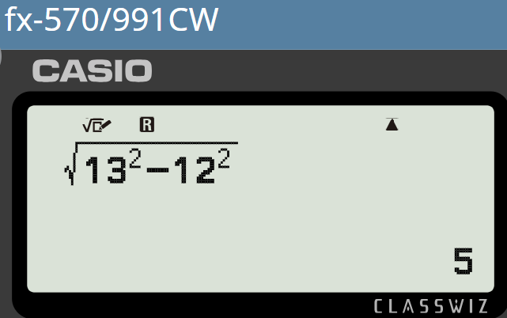

Evaluating without changing the subject
2) A right triangle has hypotenuse 13 cm, and one shorter length of 12 cm
c
b) Rearrange to make a the subject, then substitute to find the remaining shorter length.
a
b
a = 5 cm

Slide 28
Evaluating without changing the subject
2c) A right triangle has hypotenuse 13 cm, and one shorter length of 12 cm
c
a) Evaluate without rearranging…
b) Rearranging first…
a
a² + 12² = 13²
b
a² = 13² − 12²
There’s a lot of similarity between the two methods. They give us the same result with a similar level of effort in this problem.
a² = 169 − 144
a² = 25
a = 5 cm
a = 5 cm

Slide 29
Evaluating expressions with and without changing the subject
When finding unknowns in equations and formula we can first change the subject, or evaluate an expression where the subject has not been changed. Both methods will give us the same result. It is down to us to decide when each method is most appropriate.

Slide 30

© Oak National Academy 2024.
Produced in partnership with Mathematics in Education and Industry.
Licensed on the Open Government Licence v3.0, except where otherwise stated. See Oak terms and conditions.

